Slide 1
SE 577 Software Architecture Architectural Styles

Slide 2
Acknowledgement
Material from several sources including:
D. Garlan and M. Shaw, “An Introduction to Software Architecture”, CMU-CS-94-166
R.N. Taylor, N. Medvidovic, and E.M. Dashofy. Software Architecture: Foundations, Theory and Practice, Wiley.
Farshidi, Jansen, and van der Wolf. Capturing software architecture knowledge for pattern-driven design. Journal of Systems and Software, 2020
Erder, Pureur, and Woods. Continuous Architecture in Practice
Richards and Ford. Fundamentals of Software Architecture
Carvantes and Kazman. Designing Software Arhitectures

Slide 3

Software Architecture - Ingredients
Most definitions of software architecture generally talk about
What are the important “architectural” components
What are the connectors between the architectural components
What patterns, constraints, or decisions govern the restrictions on connecting the architectural components.
Think about it, not all ways to connect architecture components together are equally good.

Slide 4
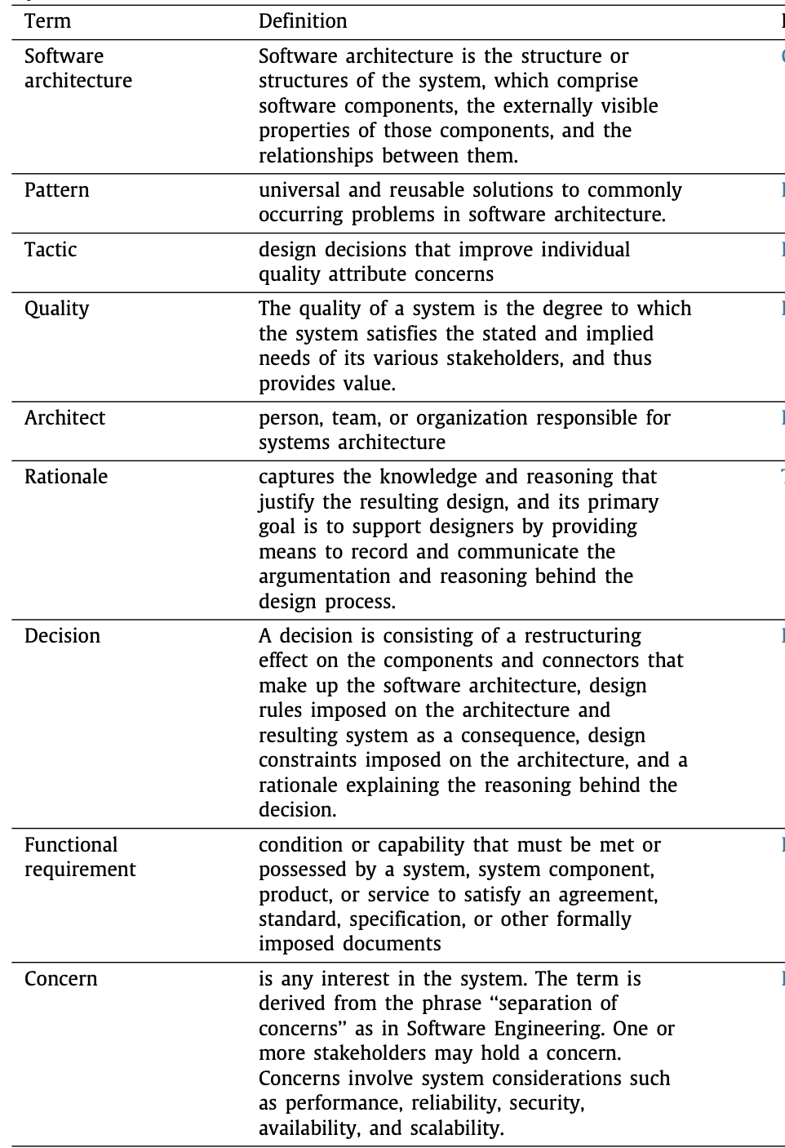
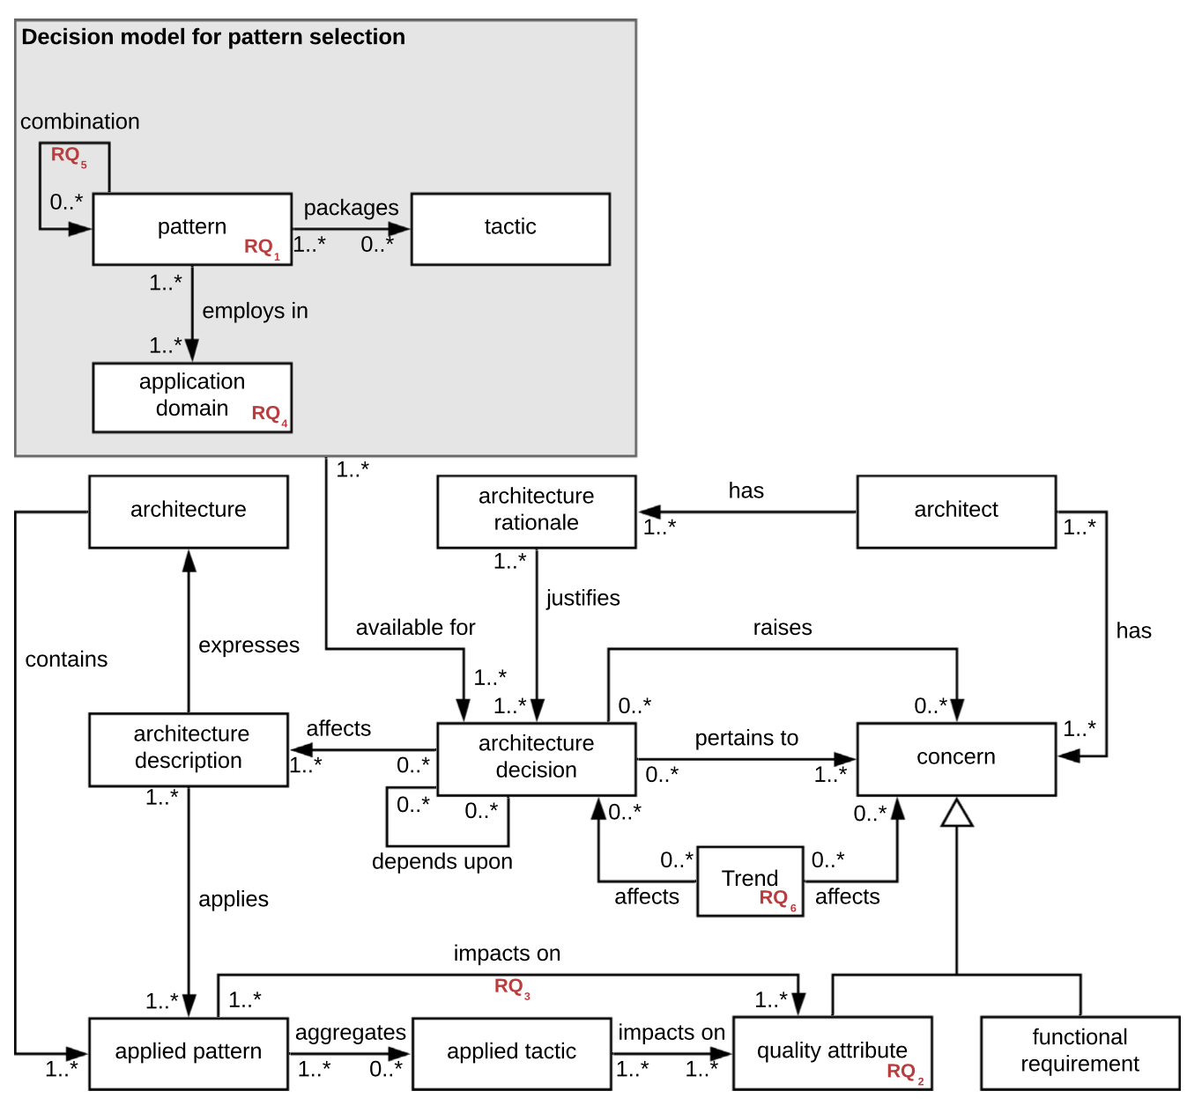

Architecture as an Algorithm
https://www.iso.org/obp/ui/#iso:std:iso-iec-ieee:42020:ed-1:v1:en

Slide 5
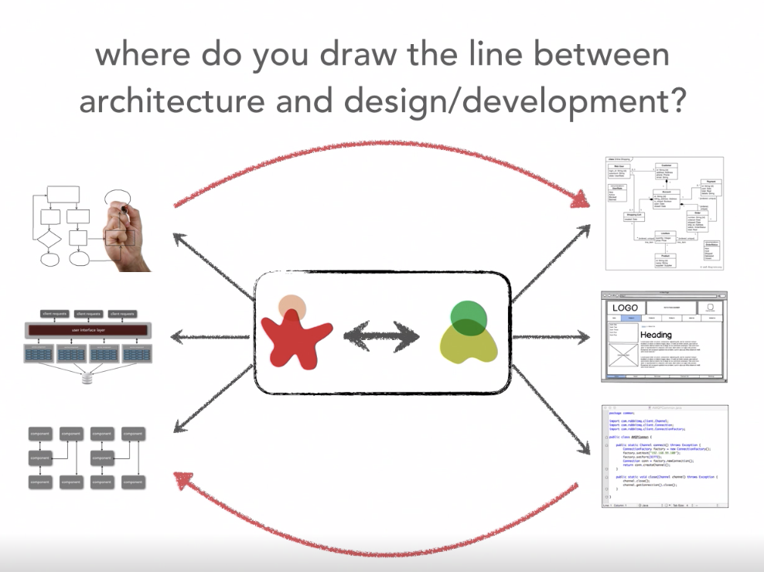
We can also look at this non- hierarchical… The relation between the architecture and design spaces
Ref: Neil Ford & Mark Richards Software Architecture Fundamentals
Bi-Directional Influence
Architecture Stuff
Design Stuff
Constituent Collaboration

Slide 6
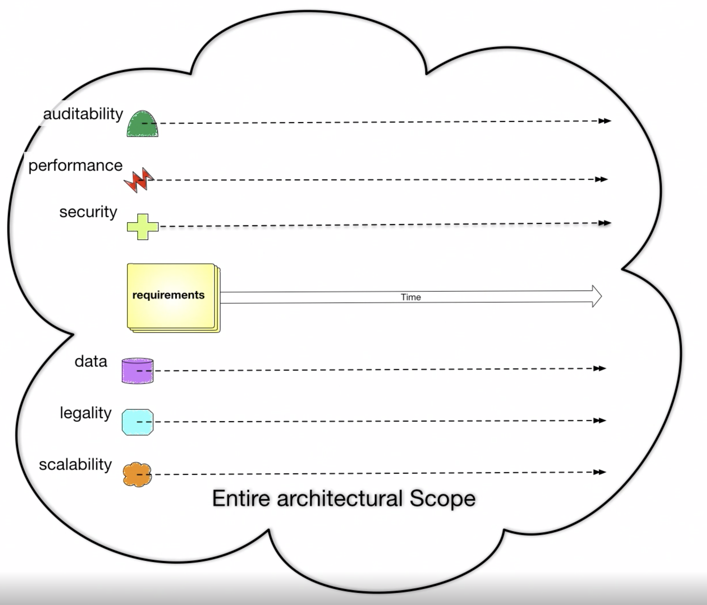
Architecture has a broader scope than design
Ref: Neil Ford & Mark Richards Software Architecture Fundamentals
Broader Architecture Focus
Design Focus

Slide 7
System Quality Attributes
Ref: https://en.wikipedia.org/wiki/List_of_system_quality_attributes
accessibility
accountability
accuracy
adaptability
administrability
affordability
agility
auditability
autonomy
availability
compatibility
composability
configurability
correctness
credibility
customizability
debugability
degradability
determinability
demonstrability
dependability
scalability
seamlessness
self-sustainability
serviceability securability
simplicity
stability
standards compliance
survivability
sustainability
tailorability
testability
timeliness
traceability
transparency
ubiquity
understandability
upgradability
vulnerability
usability
deployability
discoverability [Erl]
distributability
durability
effectiveness
efficiency
evolvability
extensibility
failure transparency
fault-tolerance
fidelity
flexibility
inspectability
installability
integrity
interchangeability
interoperability [Erl]
learnability
maintainability
manageability
mobility
modifiability
modularity
operability
orthogonality
portability
precision
predictability
process capabilities
producibility
provability
recoverability
relevance
reliability
repeatability
reproducibility
resilience
responsiveness
reusability [Erl]
robustness
safety
These attributes and the tradeoffs associated with them influence architecture and design decisions

Slide 8
System Quality Attributes
Ref: https://en.wikipedia.org/wiki/List_of_system_quality_attributes
Although there are many quality attributes, certain ones tend to appear again and again that impact the design and architecture of systems
Modularity
Maintainability
Testability
Availability
Deployability
Reliability
Scalability
Evolvability
Affordability
++ FEASIBILITY ++

Slide 9
Blockchain Demo – Quality Attributes and Design
Kubernetes
Blockchain UI Pod
Blockchain UI Service
container
Localhost:30133
/
GoLang Solver API Pod
GoLang Solver Service
/api/go
container
Browser
/api/node
NODE Solver Service
NODE Solver API Pod
HA Proxy Ingress Controller
/api/kotlin
container
Kotlin Solver Service
Kotlin Solver API Pod
/api/rust
container
RUST Solver Service
RUST Solver API Pod
container

Slide 10
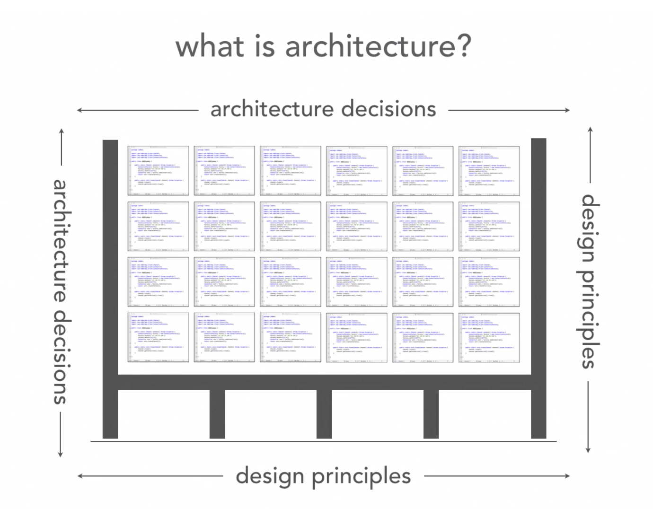
The structure of the source code should not be determined arbitrarily
Ref: Neil Ford & Mark Richards Software Architecture Fundamentals
What holds up the source code structure?

Slide 11
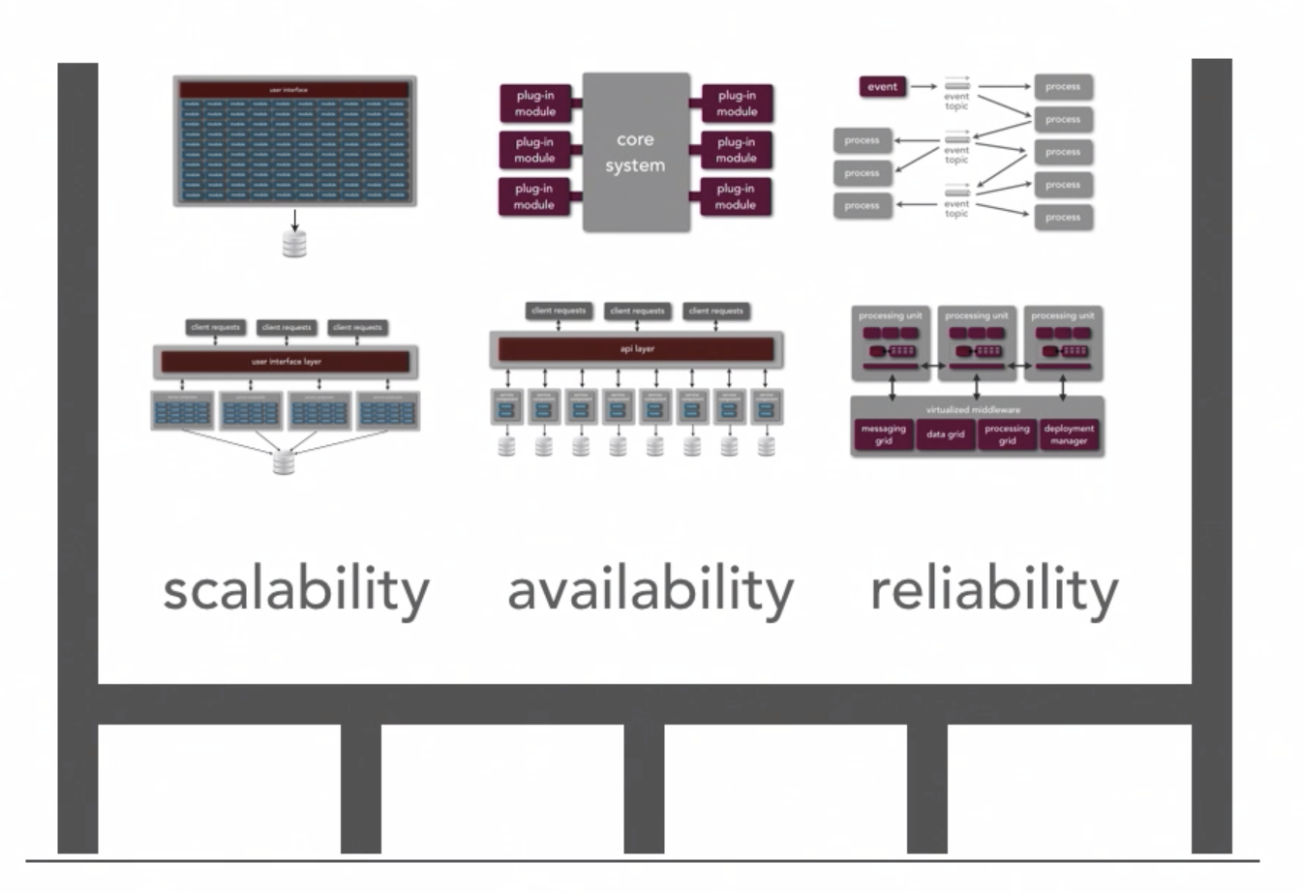
Starting with understanding the structure of the system
Ref: Neil Ford & Mark Richards Software Architecture Fundamentals
We can use architecture styles and patterns to structure the system
Needed quality attributes will also help dictate the system structure

Slide 12
Back to Architecture Basics
When I introduced the vocabulary of architecture components
Terms used: Components, Connectors, Structures, and so on.
I like to think about architecture in terms of laying out the foundation for design
What design decisions do we need to make, and/or what structures do we need to document in order to realize all of the constraints imposed on the system
Constraints typically come from the non-functional requirements – time to market, budget, technology standards, skillsets, etc
Good architecture makes important decisions early and defers less-important decisions to later
Do we really need to pick the database technology up front?
How much should the fact that the system is web-based influence the overall design, can we abstract this for now and specify it later?

Slide 13
Architecture and Design Patterns
Architecture Style
Defines the vocabulary of the components and connectors in a software architecture and the constraints on how they can be combined.
Example: Pipe and Filter
Architecture Patterns
Focus is on the organization of the overall system
An instance of an architecture style
Design Patterns
Focus is on the organization of a block of code

Slide 14
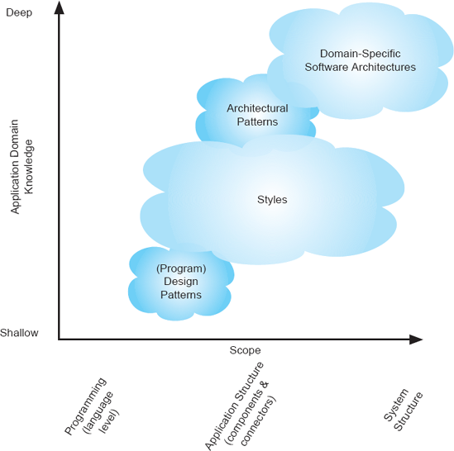
Software Architecture Landscape
Also known as a reference architecture, is the set of principal design decisions that are simultaneously applicable to multiple related systems, typically within an application domain, with explicitly defined points of variation
An architectural pattern is a named collection of architectural design decisions that are applicable to a recurring design problem, parameterized to account for different software development contexts in which that problem appears.
.
An architectural style is a named collection of architectural design decisions that (1) are applicable in a given development context, (2) constrain architectural design decisions that are specific to a particular system within that context, and (3) elicit beneficial qualities in each resulting system.
R.N. Taylor, N. Medvidovic, and E.M. Dashofy. Software Architecture: Foundations, Theory and Practice, Wiley.

Slide 15
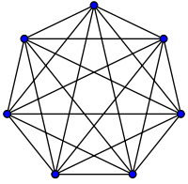
Remember every system has an architecture – Our first architecture pattern
Lets call this the “ball of mud” architecture pattern – it meets the definition Constraints of this pattern – every component is allowed to directly talk to every other component – in other words – there are no constraints Thus, introducing a new component, allows for an additional n-1 connections where n is the total number of components

Slide 16
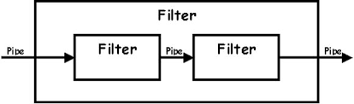
Another Architecture Pattern – this one a little more realistic
The Pipe-and-Filter is a classic architecture pattern – its actually the basis for some of the goodness in functional programming and other design patterns such as the builder pattern
Components are the filters – all inputs are provided by pipes, all transformations are done by filters. Filters are stateless, all transformations are based on pipe inputs
The filters can ingest inputs and produce outputs atomically or via streaming

Slide 17
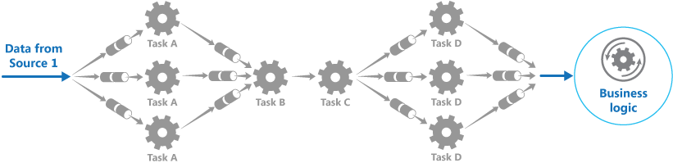
Another Architecture Pattern – this one a little more realistic
The Pipe-and-Filter is also powerful because there can be special filters that split data and other filters that coordinate merging of data
This enables large scale and concurrency

Slide 18
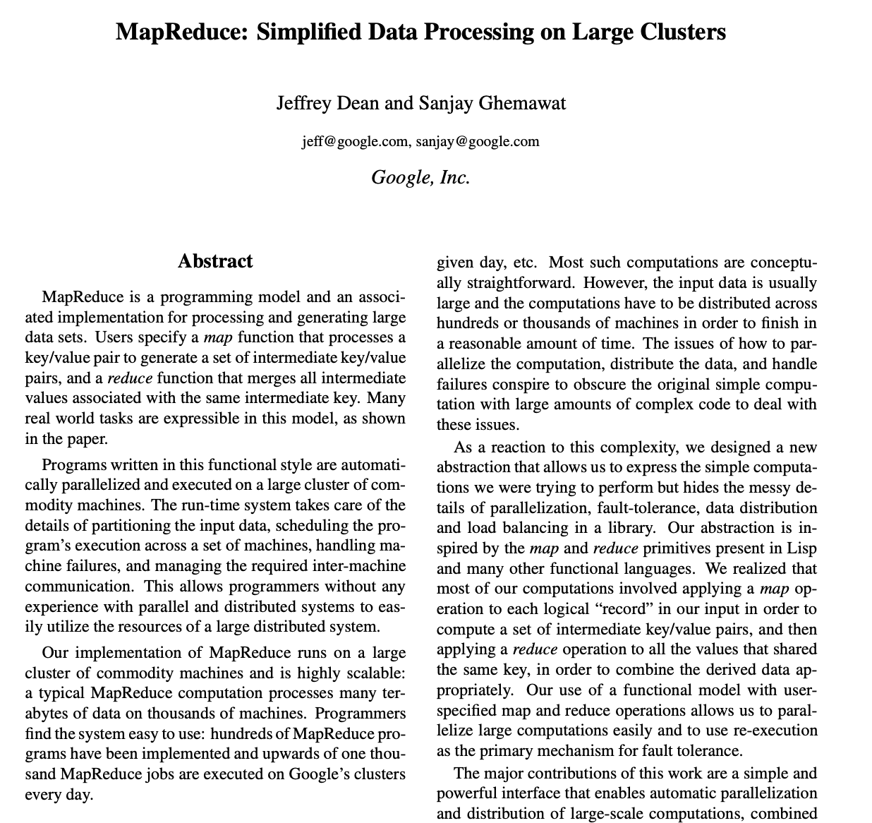
Pipe and Filter is very useful in the real world
This is the seminal paper by google on MapReduce – basically an at scale implementation of pipe-and-filter

Slide 19
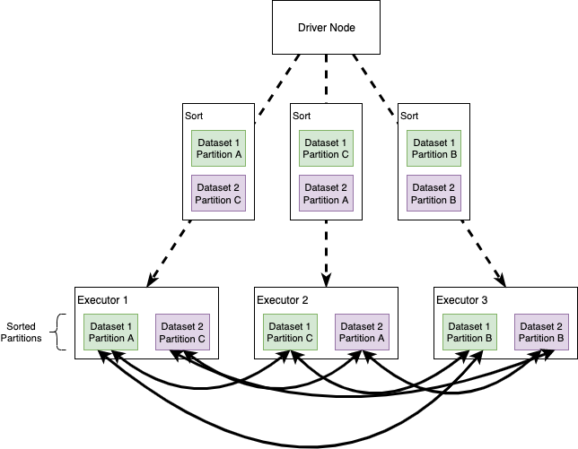
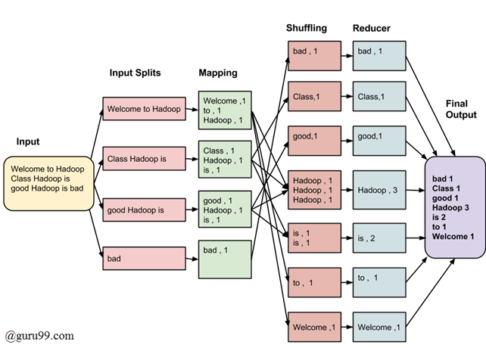


Pipe-and-Filter used as at scale data pipelines

Slide 20
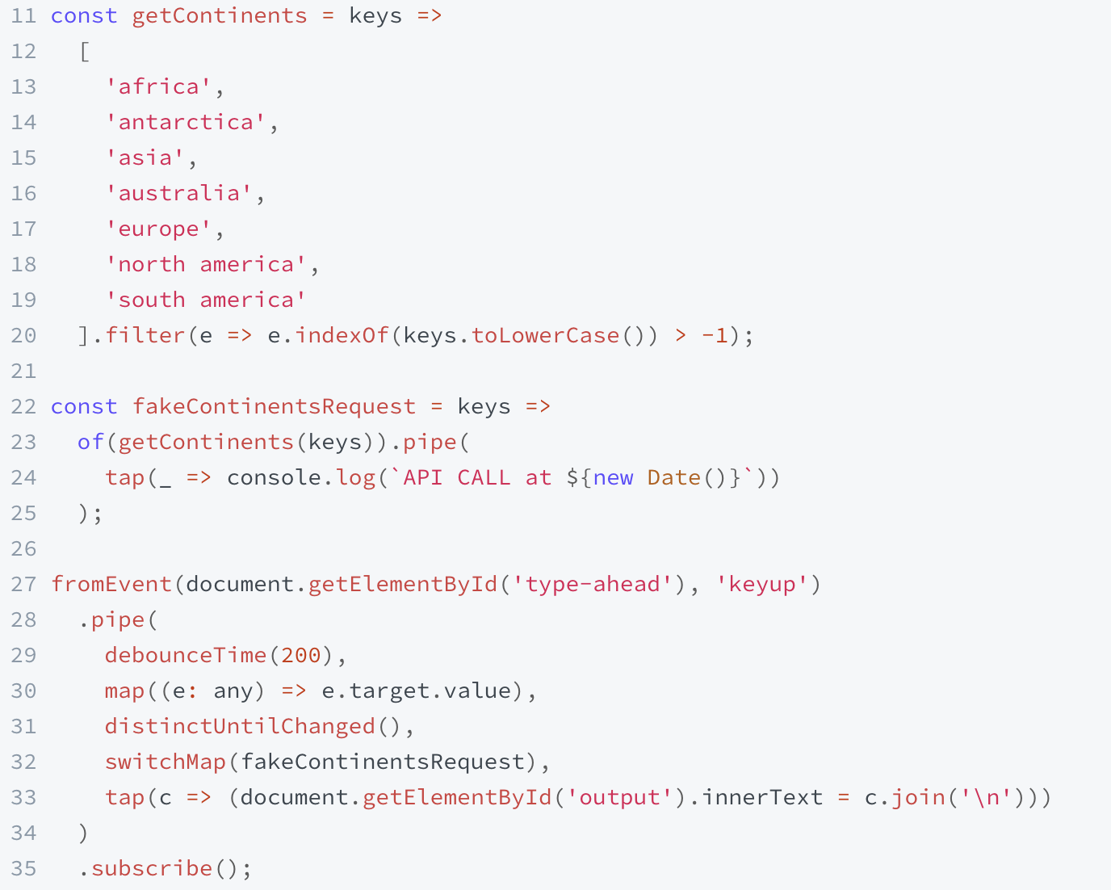
Pipe-and-Filter – Functional Programming
Demo at: https://www.learnrxjs.io/learn-rxjs/recipes/type-ahead

Slide 21
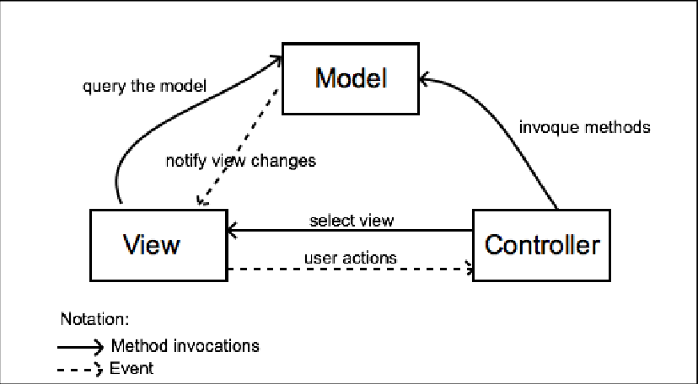
An example of an architecture pattern – MVC (Model/View/Controller)
MVC is a more realistic example of an architecture style
View is passive, reacts to changes – updates data based on model events, updates presentation based on controller reacting to user behavior
Application state fully managed by model

Slide 22
Sidebar – Architecture Style versus Architecture Pattern?
If you study classic references for software architecture you will see that architecture styles and patterns are considered different things…
While we can form a general understanding of their differences based on abstraction (e.g., pipe/filter vs MVC)…
In practice, they can generally be used interchangeably – Ill generally just call them architecture styles

Slide 23
Architecture Styles
Architecture Styles Define and Constrain the:
The components of the solution
What are the major computational units of the solution
Eg., Security, Data Access, Protocol Handling, …
The connectors of the solution
How are the interactions between the components realized
Eg., procedure calls, network calls, events, broadcasts, …
The properties of the solution
What are the quality attributes and non-functional requirements
Eg., pre/post conditions, availability specifications, interface semantics, …

Slide 24
Architecture decisions and design principles also influence the system structure
Ref: Neil Ford & Mark Richards Software Architecture Fundamentals
Things that make the solution performant, scalable, modular, maintainable, testable, and so on
Things that make the code performant, scalable, modular, maintainable, testable, and so on

Slide 25
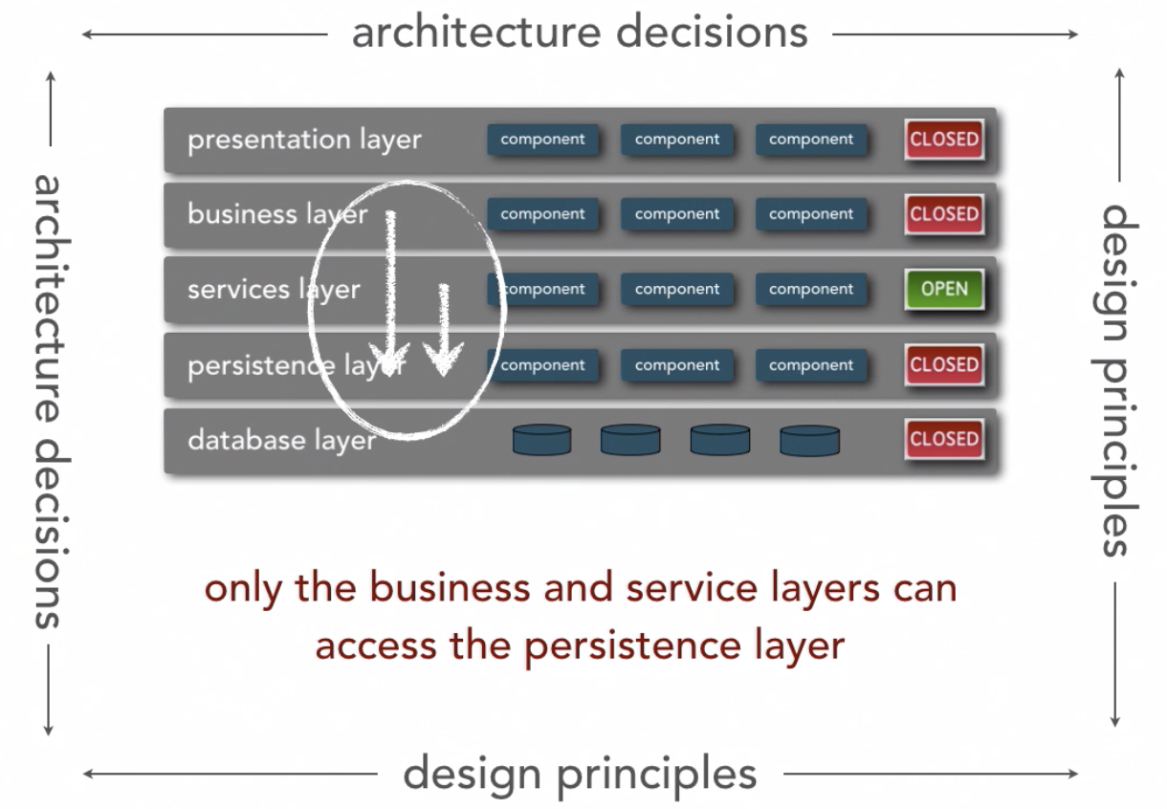
Architecture principal example
Ref: Neil Ford & Mark Richards Software Architecture Fundamentals
Reduces coupling by only allowing components to communicate to adjacent layers or within the same layer

Slide 26
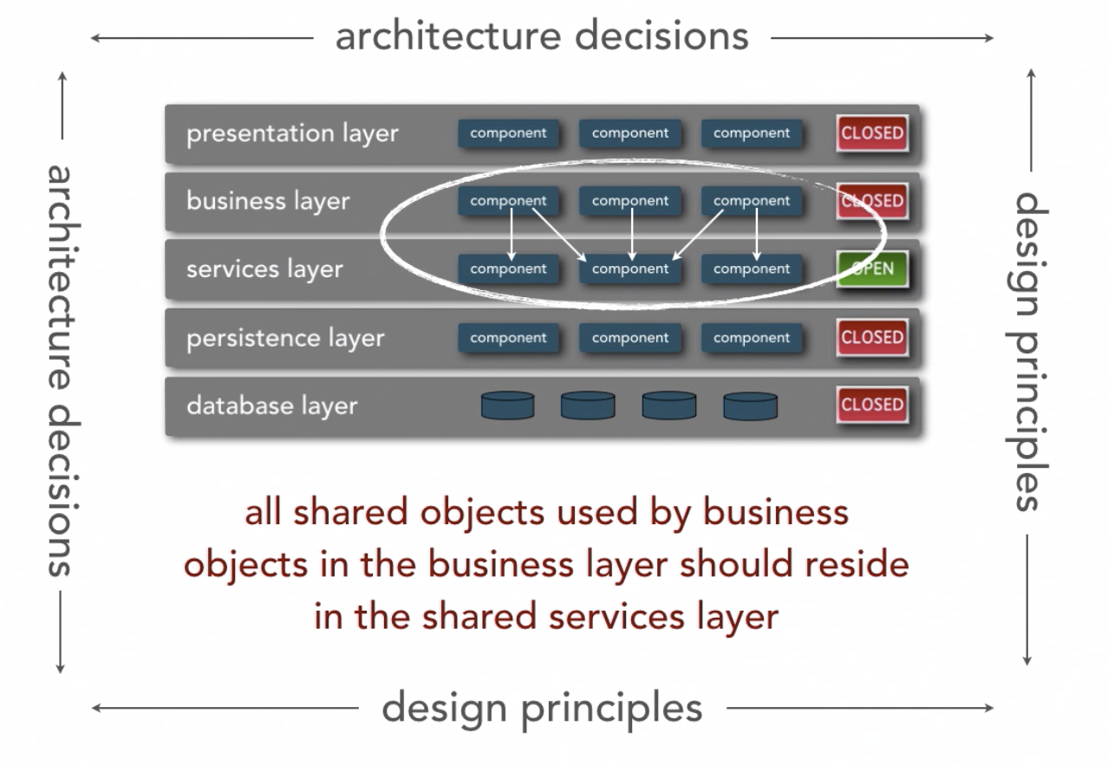
Another architecture principal example…
Ref: Neil Ford & Mark Richards Software Architecture Fundamentals
Implies reuse emphasis will be in the services layer

Slide 27
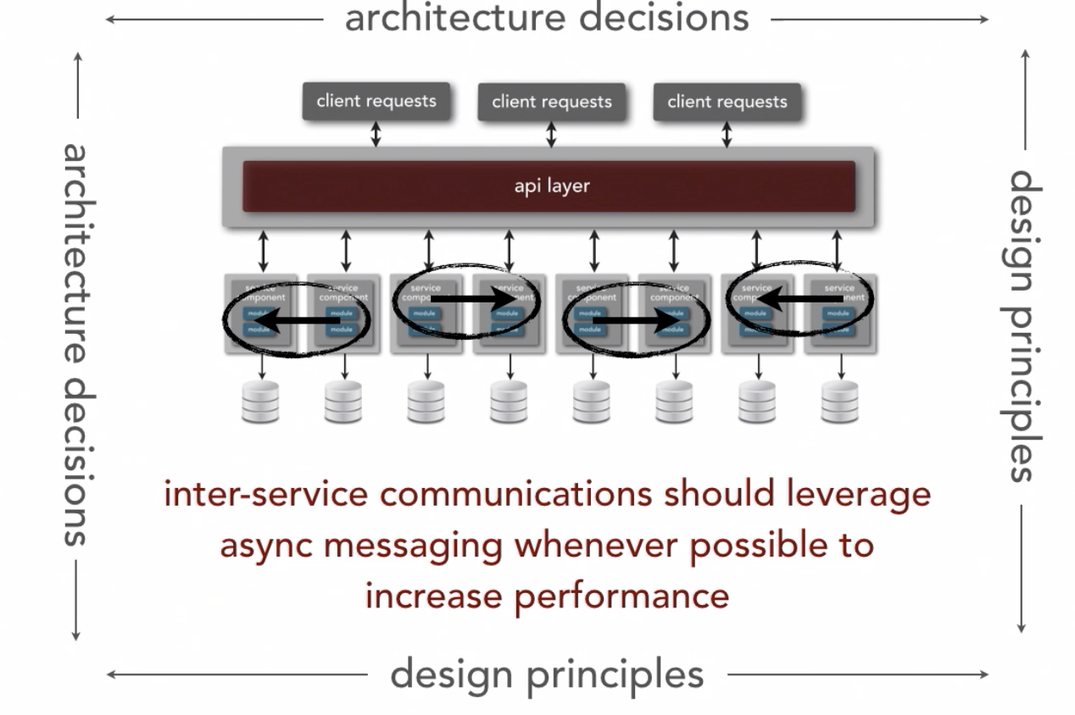
Design principles can impact many platform and technology aspects
Ref: Neil Ford & Mark Richards Software Architecture Fundamentals
A design decision that has been shown to have good performance characteristics…
Tradeoff is introduction of complexity

Slide 28
Back to Architecture
The previous definitions presented focus on the vocabulary of architecture components
Terms used: Components, Connectors, Structures, and so on.
I like to think about architecture in terms of laying out the foundation for design
What design decisions do we need to make, and/or what structures do we need to document in order to realize all of the constraints imposed on the system
Constraints typically come from the non-functional requirements – time to market, budget, technology standards, skillsets, etc
Good architecture makes important decisions early and defers less-important decisions to later
Do we really need to pick the database technology up front?
How much should the fact that the system is web-based influence the overall design, can we abstract this for now and specify it later?

Slide 29
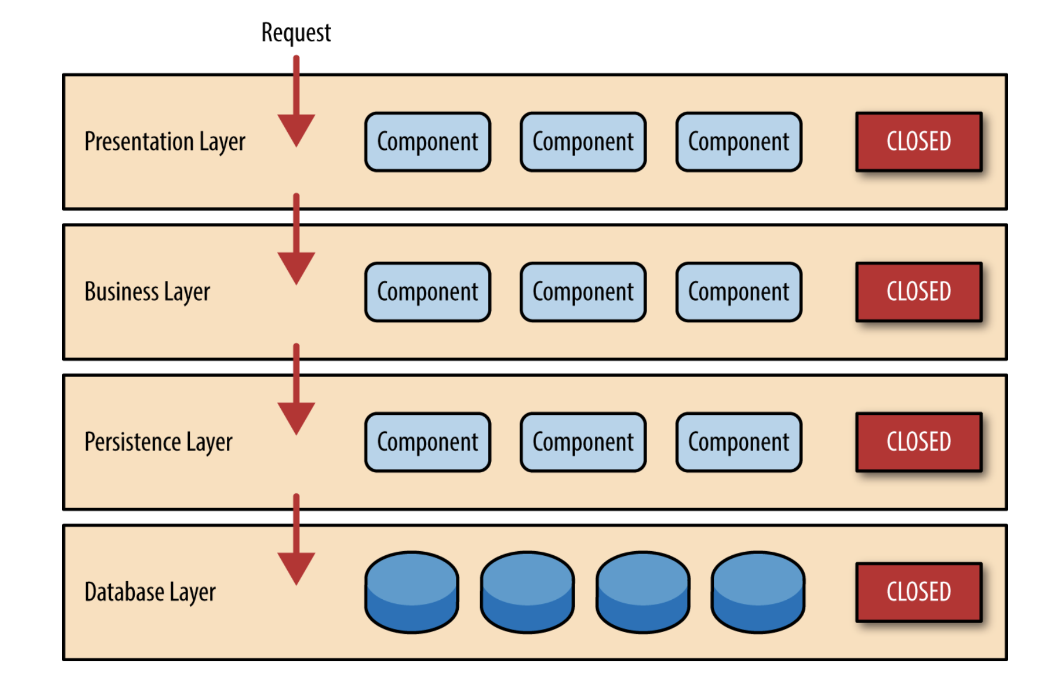
Layered Style
Basic Principle is that you can only interact in one direction with an adjacent layer

Slide 30
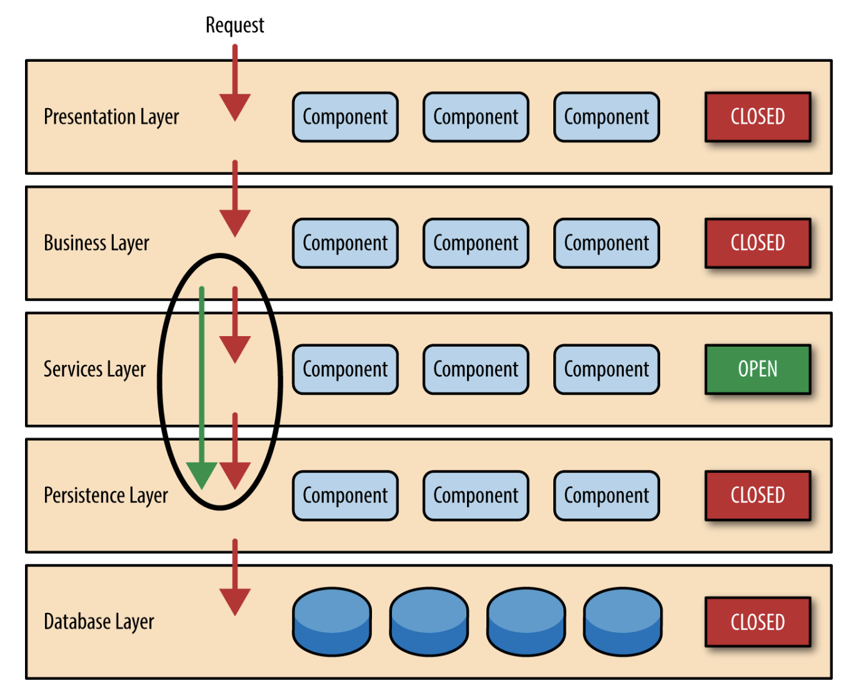
Layered Style
Sometimes Layers are Open To Bypassing

Slide 31
Pipe and Filter
The pipe & filter architecture style is used to wire together processing components
Producer
Starting component, initiates activity
Transformer
Input, Processing, Output
Observer
Input, Discard, Pass-through
Splitter
Input, Optional Processing, Multiple Outputs
Merger
Collect Multiple Inputs, Process, Output
Consumer
Ending component, stop here

Slide 32
Pipe and Filter
The pipe & filter architecture style is used to wire together processing components
Language Serializer
Service Definition
Service Compiler
Language Deserializer
Java Object
Java Serializer
Node Object
JavaScript Serializer
Network Writer
Network Reader
Python Deserializer
GoLang Struct
GoLang Serializer
Python Object

Slide 33
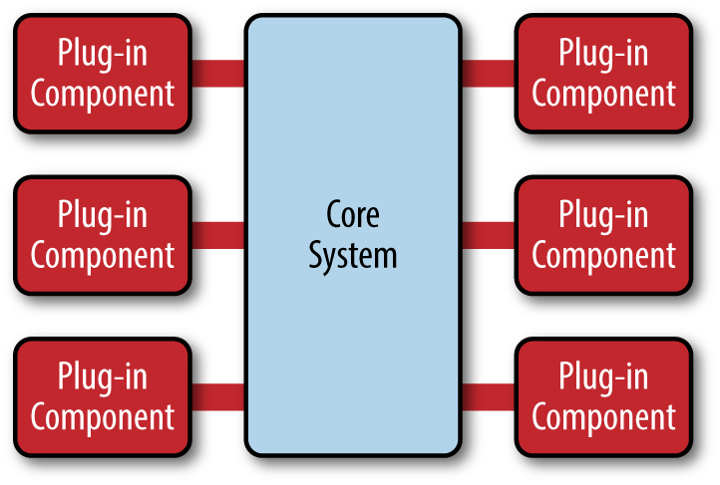
Microkernel Architecture Style
A common architecture style for Software as a Service solutions
The “Core System” provides the value added functionality out of the box The “Plug In Component” can be other purchased software specific to an industry vertical (e.g., healthcare, telecom, etc), or custom code taylored to a specific need.
Often-times the core system will prove an API or SDK to enable the plug-in ecosystem

Slide 34





Microkernel Architecture Style - Examples

Slide 35
Event Architectures – Event Notification
Event ”React To Something"
What Happened
S1
S2
S3
S4
Publish
Event
Subscribe
Event
e1
Command ”Do Something"
Event Notification Loosen coupling with pub/sub patterns
Interest is only in if the event has occurred
Source: The Many Meanings of Event-Driven Architecture – Martin Fowler

Slide 36
Event and Streaming Architectures
S1
S2
S3
S4
Publish
Event
Subscribe
Event
e1
Before State After State
Event Carried State Transfer Loosen coupling with pub/sub patterns
Eventual Consistency
Source: The Many Meanings of Event-Driven Architecture – Martin Fowler

Slide 37
Event – Event Carried State Transfer
(2) Notify Event
S1
S2
S3
S4
(3) Update App State
(1) Publish
Event
e5
Event Store
Before State After State
e1
e2
e3
e4
Event Sourcing Event Store Maintains State Over Time
Loosens Coupling
Source: The Many Meanings of Event-Driven Architecture – Martin Fowler

Slide 38
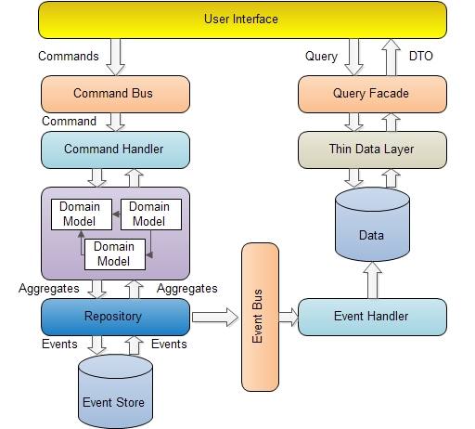
Event – Command Query Responsibility Separation
Writes
Reads
Scalability and Consistency via Separate Handling of Reads and Writes (CQRS)

Slide 39
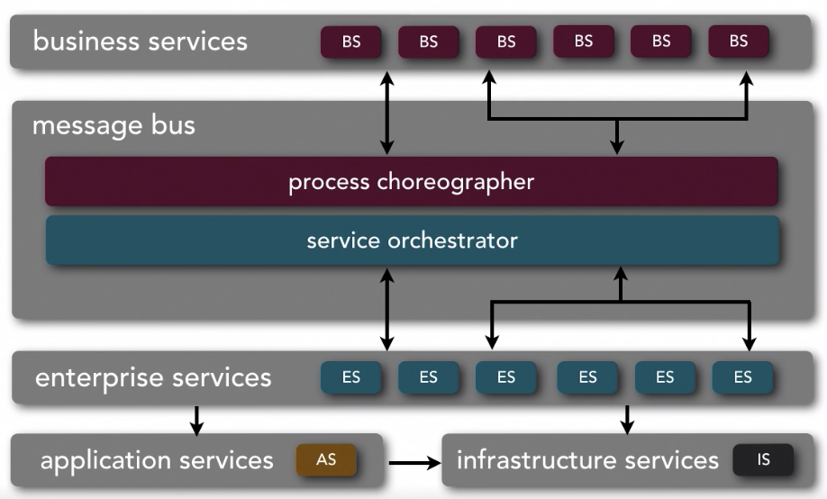
Service Oriented Architecture Style
Ref: Neil Ford & Mark Richards Software Architecture Fundamentals
Thoughts? Good Parts? Bad Parts?

Slide 40
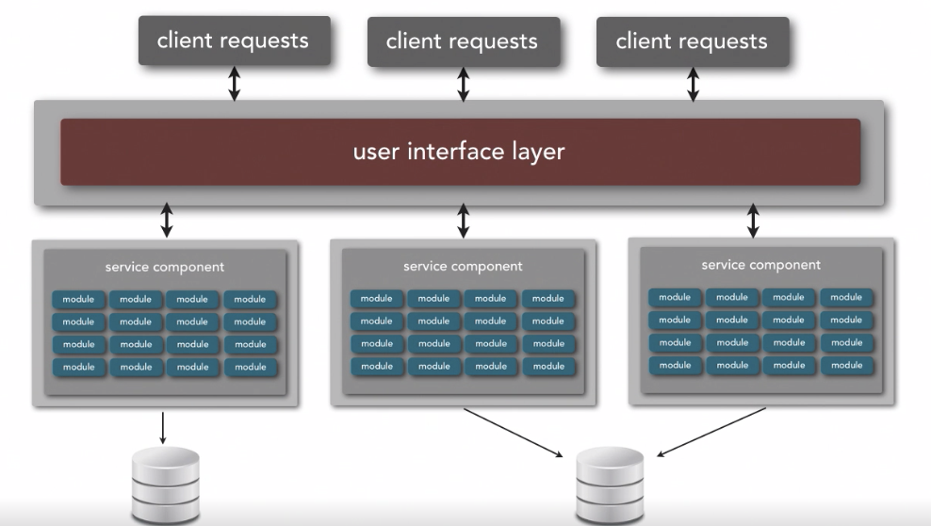
Service Based Style
Ref: Neil Ford & Mark Richards Software Architecture Fundamentals
http or grpc
http or grpc
http or grpc
API GATEWAY
http or grpc
http or grpc
http or grpc
Works Well To Partition Functionality

Slide 41
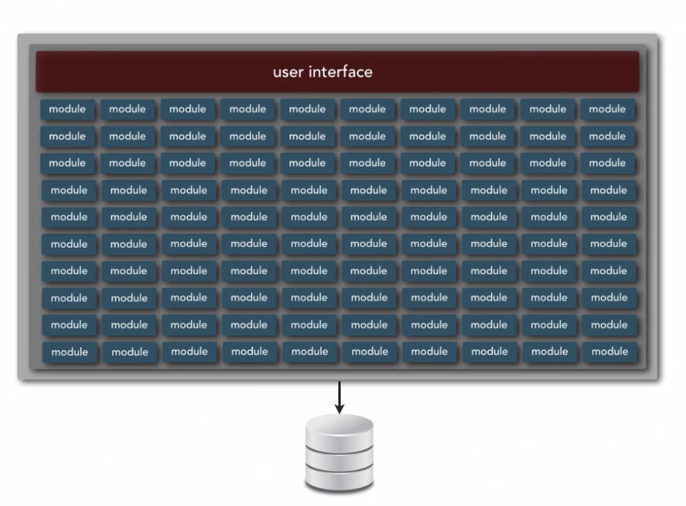
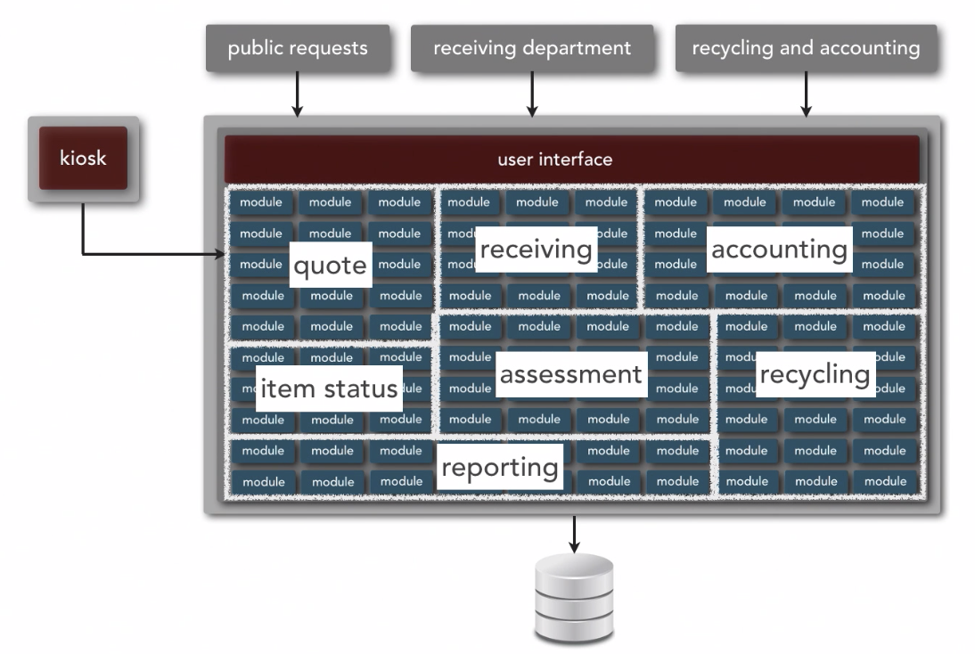
Service Based Style - Example
Ref: Neil Ford & Mark Richards Software Architecture Fundamentals
Generally Good To Decompose a Monolithic Application

Slide 42
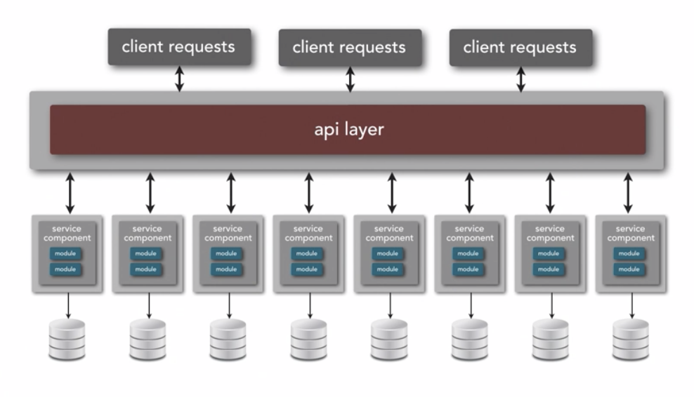
Microservice Architecture
Ref: Neil Ford & Mark Richards Software Architecture Fundamentals
Basic Idea – SHARE NOTHING

Slide 43
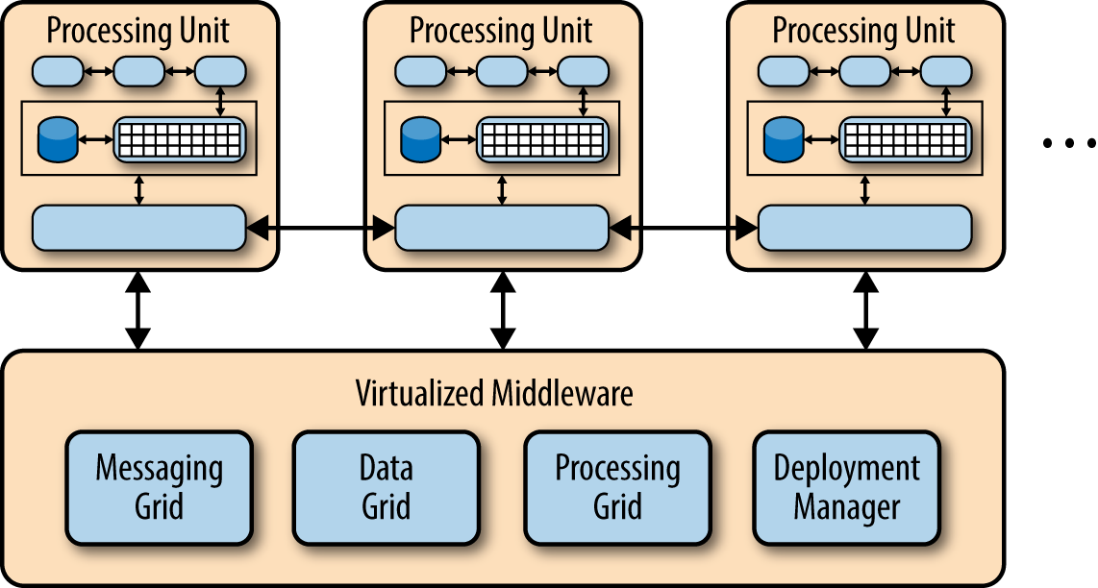
Space-Based Architecture (aka Cloud)
Ref: Neil Ford & Mark Richards Software Architecture Fundamentals
Basic Idea – Minimize Factors that Limit Scaling

Slide 44
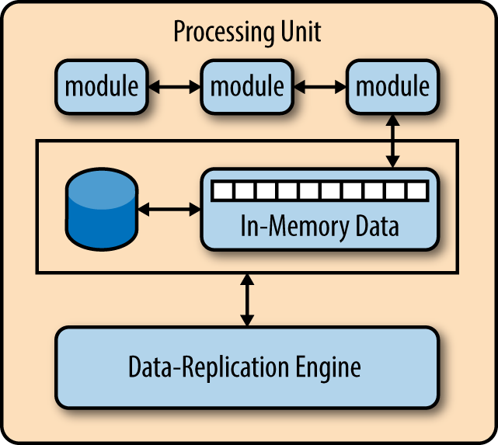
Space-Based Architecture– Key Components
Ref: Neil Ford & Mark Richards Software Architecture Fundamentals
The virtual middleware connects to all processing units
Messaging Grid: Behaves like a smart load balancer, intelligently routing messages to processing units
Data Grid: Works with the data replication components in each processing unit to make sure the right data is replicated to the right Processing Unit and kept coherent
Processing Grid: Mediates and orchestrates distributed work that is executed on multiple processing units
Deployment Manager: Ensures the right code is deployed to the right processing unit as well as handling scaleup and scale down
The processing unit provides a virtualized environment that enables modules to have everything that they need appear to be local
Basic Idea – Minimize Factors that Limit Scaling

Slide 45
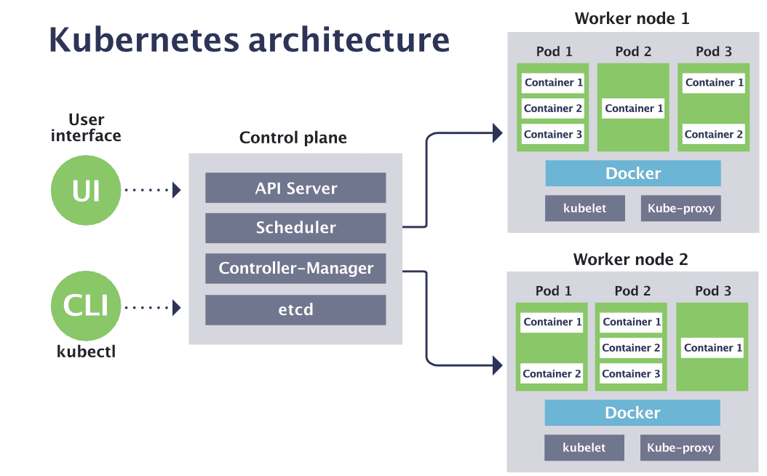
Space-Based Architecture– Example: Kubernetes

Slide 46
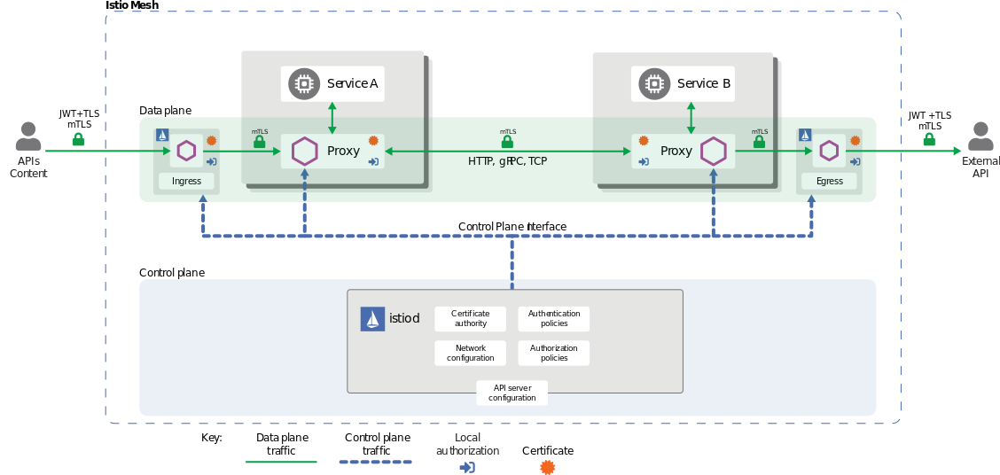
Space-Based Architecture– Example: Service Mesh on Kubernetes

